Slide 1
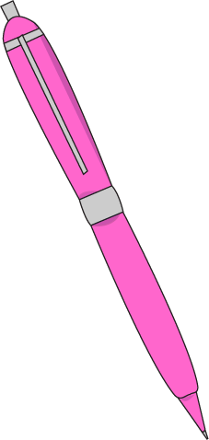
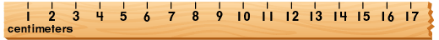
Daily Review
When measuring with a ruler, you just need to remember two simple rules:
always start from zero, and
only use the closest line: don’t guess!
Which of the two examples below shows the pen being measured correctly? Why?
10.7 cm
1.
centimetres
9.0 cm
2.
centimetres

Slide 2
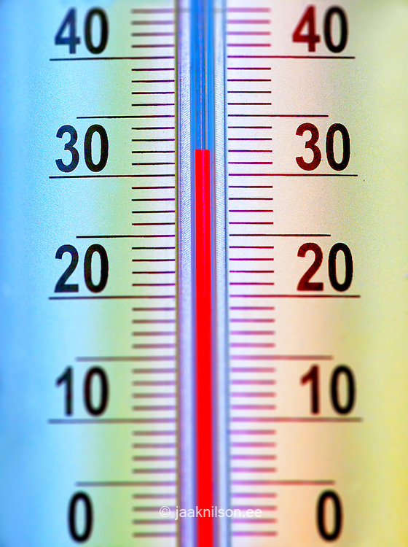

Daily Review
Thermometers
When measuring with a thermometer, there are also two simple rules:
always read the thermometer at eye level, and
only use the closest line: don’t guess!
A student sat at her desk and read a thermometer on the wall. She read the temperature to be 34ºC.
Is she correct? Why?

Slide 3
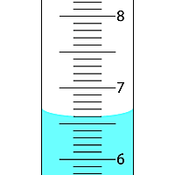
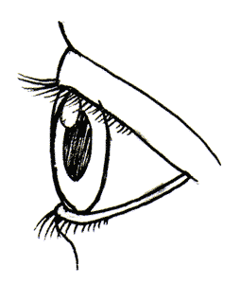
Daily Review
Measuring Cylinders
When measuring with a measuring cylinder, there are another two simple rules:
always read the measuring cylinder at eye level, and
only use the closest line to the bottom of the meniscus.
Which eye is reading the volume correctly? Explain your answer.
C
A
B
A
B

Slide 4
Daily Review
Balances
When measuring with a balance, there are two simple rules:
always make sure that the balance is flat, and
always press the Zero button before adding what you want to weigh.
Put the steps for using an electronic balance in the correct order on your whiteboards.
Press the zero button
Place the empty container on the balance
Add the substance to the container
Place the balance on a flat surface

Slide 5
Unit Conversions Year 7 Science

Slide 6
Learning Objectives
CFU
What are we going to learn?
We are learning to:
Convert between common units of measurement.
Common units of measurement:
Centimetres
Metres
Seconds
Minutes
Grams
Kilograms
Activate Prior Knowledge
For the situations below write on your whiteboard the units of measurement that you could use.
The length of the classroom
The length of your pencil
The time it takes you to run 15 metres
The mass of your school bag
Vocabulary
Convert: To change the form

Slide 7
Concept Development
CFU
Which unit would be the best to measure the distance between Perth and Sydney? Why?
During experiments scientists sometimes need to record their measurements using different units of measurement.
Some units of measurement are suited to large quantities and others are suited to smaller quantities.
Scientists might measure length in different units, for example
- Centimetres (cm)
- Metres (m)
- Kilometres (km)
Vocabulary
Convert: To change the form

Slide 8
Concept Development
CFU
Why might a scientist need to convert between different units of measurement?
During experiments scientists sometimes need to record their measurements using different units of measurement.
To combine and compare these different units scientists need to be able to convert them to the same form.
Common conversions that scientists need to do include:
Centimetres to metres (when measuring distance)
Grams to kilograms (when measuring mass)
Seconds to minutes (when measuring time)
Vocabulary
Convert: To change the form

Slide 9
Skill Development/Guided Practice
CFU 1
What do we measure in centimetres and metres?
When measuring distance scientists might record their measurements using centimetres for small measurements or metres for large measurements.
CFU 2
How do we move the decimal point?
Converting metres to centimetres (Remember: 1m = 100 cm)
Step 1. Determine the units you are converting to.
Step 2. Multiply the number by 100, by moving the decimal point 2 places to the right. If there are not enough numbers to move the decimal place, add zeros as necessary.
Step 3. Rewrite your number and add the correct units.
CFU 3
What do we add if there are not enough numbers?
CFU 4
Convert 3.7m into cm. Show how you do it.
CFU 5
Convert 84.2m into cm. Show how you do it.
Convert 2.5m into cm
Step 1: Converting to cm
Step 2: Move the decimal point 2 places to the right 2.50
Step 3: Rewrite the number with units 250cm
Vocabulary
Convert: To change the form
Notes:
They are better at multiplying than dividing so I would put that first. Steps are fine – there is not really any other way to do it that I can think of 😐

Slide 10
Skill Development/Guided Practice
CFU 1
What do we measure in centimetres and metres?
When measuring distance scientists might record their measurements using centimetres for small measurements or metres for large measurements.
CFU 2
How do we move the decimal point?
Converting centimetres to metres (Remember: 1m = 100 cm)
Step 1. Determine the units you are converting to.
Step 2. Divide the number by 100, by moving the decimal point 2 places to the left. If there are not enough numbers to move the decimal place, add zeros as necessary.
Step 3. Rewrite your number and add the correct units.
CFU 3
What do we add if there are not enough numbers?
CFU 4
Convert 714cm into m. Show how you do it.
CFU 5
Convert 82cm into m. Show how you do it.
Convert 215cm into m
Step 1: Converting to m
Step 2: Move the decimal point 2 places to the left 215.0
Step 3: Rewrite the number with units 2.15m
Vocabulary
Convert: To change the form
Notes:
They are better at multiplying than dividing so I would put that first. Steps are fine – there is not really any other way to do it that I can think of 😐

Slide 11
Skill Development/Guided Practice
CFU 1
What do we measure in grams and kilograms?
When measuring mass scientists might record their measurements using grams for small measurements or kilograms for large measurements.
CFU 2
How do we move the decimal point?
CFU 3
What do we add if there are not enough numbers?
Converting kilograms to grams (Remember: 1000g = 1kg)
Step 1. Determine the units you are converting to.
Step 2. Multiply the number by 1000, by moving the decimal point 3 places to the right. If there are not enough numbers to move the decimal place, add zeros as necessary.
Step 3. Rewrite your number and add the correct units.
CFU 4
Convert 19kg into g. Show me how you do it
CFU 5
Convert 6kg into g. Show me how you do it
Convert 2kg into g
Step 1: Converting to g
Step 2: Move the decimal point 3 places to the right 2.000
Step 3: Rewrite the number with units 2000g
Vocabulary
Convert: To change the form

Slide 12
Skill Development/Guided Practice
CFU 1
What do we measure in grams and kilograms?
When measuring mass scientists might record their measurements using grams for small measurements or kilograms for large measurements.
CFU 2
How do we move the decimal point?
CFU 3
What do we add if there are not enough numbers?
Converting grams to kilograms (Remember: 1000 g = 1 kg)
Step 1. Determine the units you are converting to.
Step 2. Divide the number by 1000, by moving the decimal point 3 places to the left. If there are not enough numbers to move the decimal place, add zeros as necessary.
Step 3. Rewrite your number and add the correct units.
CFU 4
Convert 1300g into kg. Show me how you do it
CFU 5
Convert 660g into kg. Show me how you do it
Convert 3400g into kg
Step 1: Converting to kg
Step 2: Move the decimal point 3 places to the left 3400
Step 3: Rewrite the number with units 3.4kg
Vocabulary
Convert: To change the form

Slide 13
Skill Development/Guided Practice
CFU 1
What do we measure in seconds and minutes?
When measuring time scientists might record their measurements using seconds for small measurements or minutes for large measurements.
CFU 2
Which part do I multiply by 60?
Converting minutes to seconds (Remember: 1:00 min = 60 sec)
Step 1. Determine the units you are converting to.
Step 2. Multiply the number of minutes by 60.
Step 3. If there are any seconds in the measurement add these on after you have multiplied.
Step 4. Rewrite your number and add the correct units.
Convert 4:30min into sec
Step 1. Convert to sec
Step 2. Multiply the minutes by 60. 4:30 4 x 60 = 240 sec
Step 3. Add on the seconds. 4:30 240 + 30 = 270
Step 4. Rewrite with the units 270sec
CFU 3
What did I do to any seconds?
CFU 4
Convert 2min to sec. Show me how you did it.
CFU 5
Convert 3:15min to sec. Show me how you did it.
Vocabulary
Convert: To change the form

Slide 14
Skill Development/Guided Practice
CFU 1
In 4:30 which part is the minutes and which part is seconds?
When measuring time scientists might record their measurements using seconds for small measurements or minutes for large measurements.
CFU 2
Which part do I divide by 60?
Converting seconds to minutes (Remember: 1:00 min = 60 sec)
Step 1. Determine the units you are converting to.
Step 2. Divide the number of seconds by 60. Keep the whole number
Step 3. Multiply the decimal by 60 to determine the number of seconds.
Step 4. Rewrite your number in minute and seconds.
Hint: Time does not use decimals
Convert 75sec into min
Step 1. Convert to min
Step 2. Divide the seconds by 60.
Keep the whole number 75 ÷ 60 = 1.25 Keep 1 minute
Step 3. Multiply the decimal by 60. 0.25 x 60 = 15 sec Keep 15 seconds
Step 4. Rewrite in minutes and 1:15 min
seconds
CFU 3
Which part did I multiply by 60?
CFU 4
Convert 2min to sec. Show how you did it.
CFU 5
Convert 75sec to min. Show how you did it.
Vocabulary
Convert: To change the form

Slide 15
Skill Closure
James has measured his height and has found it to be 145cm. His friend Tina is 1.5m tall. James says that he is taller because 145 is larger than 1.5. Convert both the measurements to metres. Is James correct? Why?
Skill Closure
A Science experiment requires 0.125 kg of sodium chloride. The scales in the laboratory only read in grams. How much sodium chloride is required in grams?
Skill Closure
It took 2:45min to dissolve sugar in water. How long is this in seconds?

Slide 16
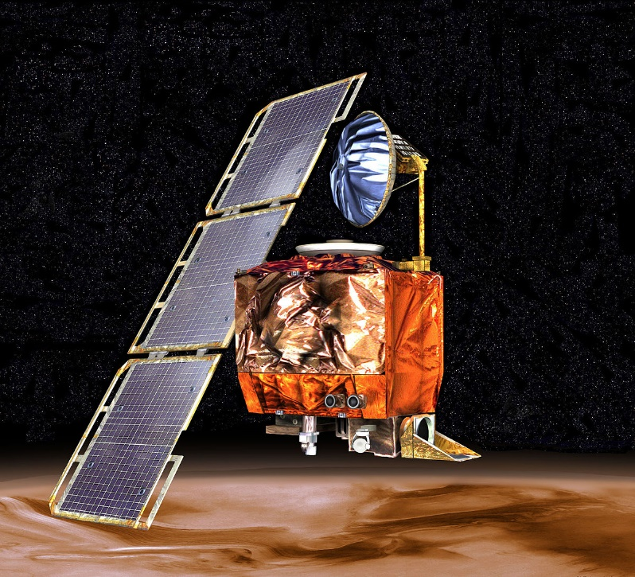
Relevance
Converting between is important when doing experiments to ensure the correct quantities are used.
It can also be useful when comparing results.
In 1999 a NASA Mars Climate Orbiter disappeared in space.
This was because the engineering team and the navigation team used different units.
As a result the wrong information was sent to the Orbiter and NASA lost $125 000 000.

Slide 17
Independent Practice
Copy the questions below into your science books and fill in the missing values.
150 cm = _____ m
75 cm = _____ m
2 m = _____ cm
3.6 m = _____ cm
3.8 kg = _____ g
4.75 kg =_____ g
4550 g = _____ kg
750 g = _____ kg
120 sec = ___:___ min
750 sec = ___:___ min
1:15 min = _____ sec
6:30 min = _____ sec
Copy the questions below into your science books and solve them.
13. Two students weighed their pencil cases. The first pencil case weighed 485g and the second weighed 0.285kg. What is the total weight of the pencil cases in grams?
14. What is the combine length of two desks if they are 75cm and 1.20m long?
15. A student is converting 675 seconds to minutes. They come up with an answer of 11.25 minutes. Explain why this is incorrect.

